Slide 1
Django - Creating a Movie Detail Page
AMI PATEL

Slide 2
CheatSheet-commands
pip install virtualenv
python –m venv <name of environment>
<name of environment>/Scripts/activate
Above steps are not mandatory you can directly start from next step
pip install django
django-admin startproject <project name>
python manage.py runserver
python manage.py startapp <app name>
python manage.py migrate
python manage.py makemigrations
python manage.py createsuperuser
Enter username, email and password

Slide 3
Contents
Creating a movie page
Implementing links to individual movie pages

Slide 4
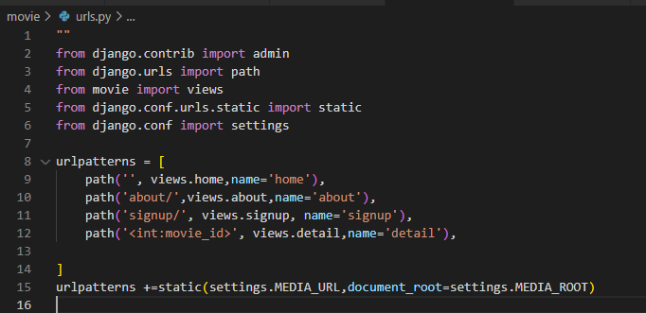
/movie/urls.py file with the following code

Slide 5
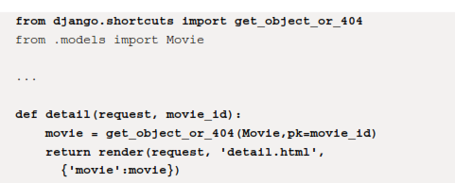
/movie/views.py, we add the def detail view

Slide 6
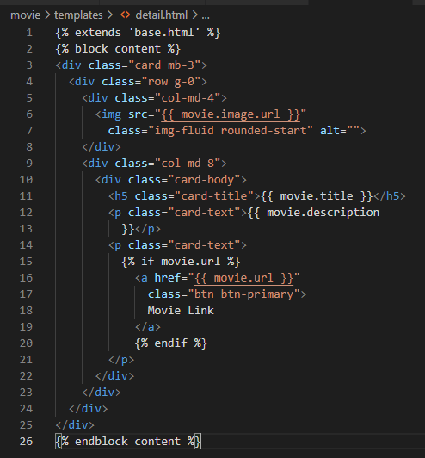
/movie/templates/detail.html

Slide 7
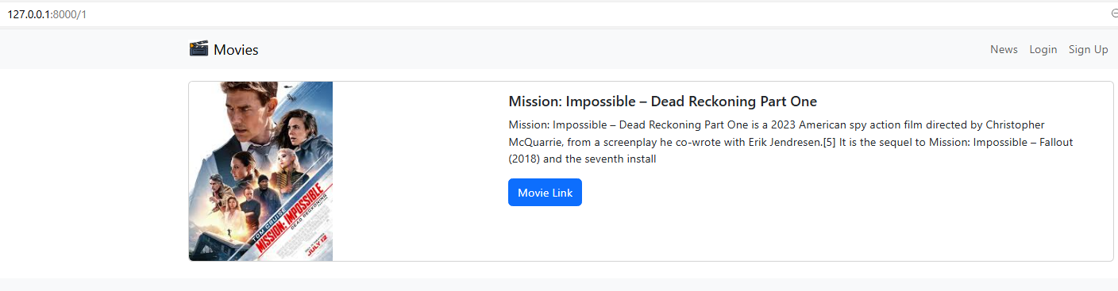
localhost:8000/1

Slide 8
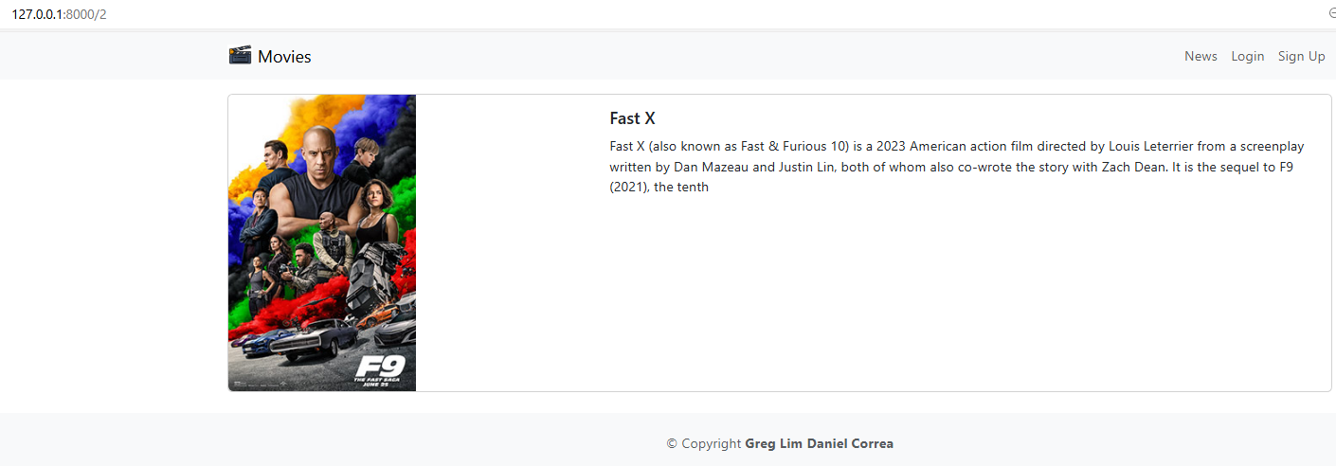
localhost:8000/2

Slide 9
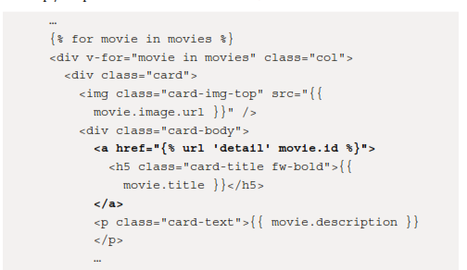
Implementing links to individual movie pages
/movie/templates/home.html:

Slide 10
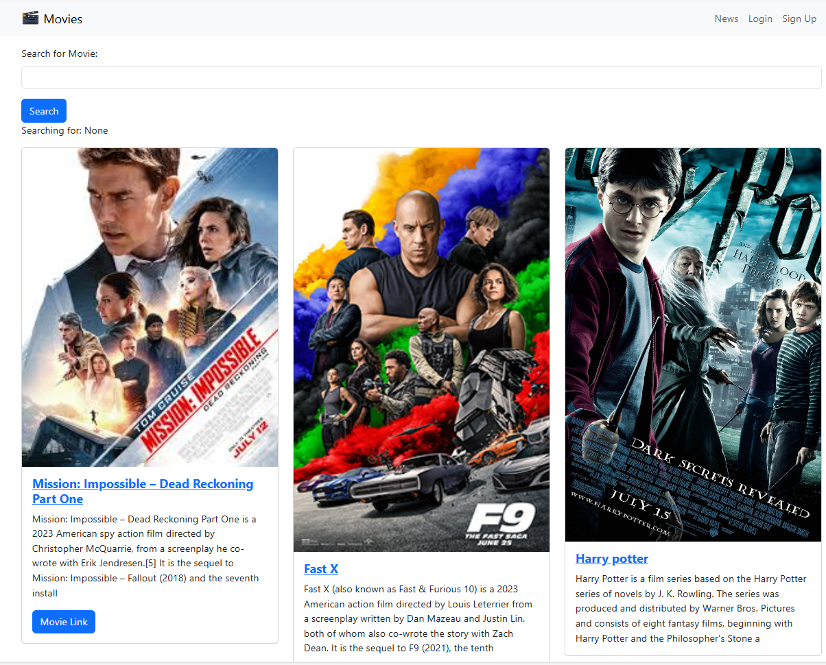

Slide 12
Thank you

